Slide 1
DPM Meeting 1
Overview of Initial Documentation and Designs

Slide 2
Roles (Preliminary)
Kareem Halabi: Team Manager
Jake Zhu: Documentation Manager
Tristan Saumure Toupin: Software Manager
Benjamin Willms: Hardware Manager
Mamoun Benchekroun: Testing Manager
Alexis Giguère-Joannette: Team Member (Software)
Richie Piyasirisilp: Team Member (General)
Quentin Norris: Team Member (General)

Slide 3
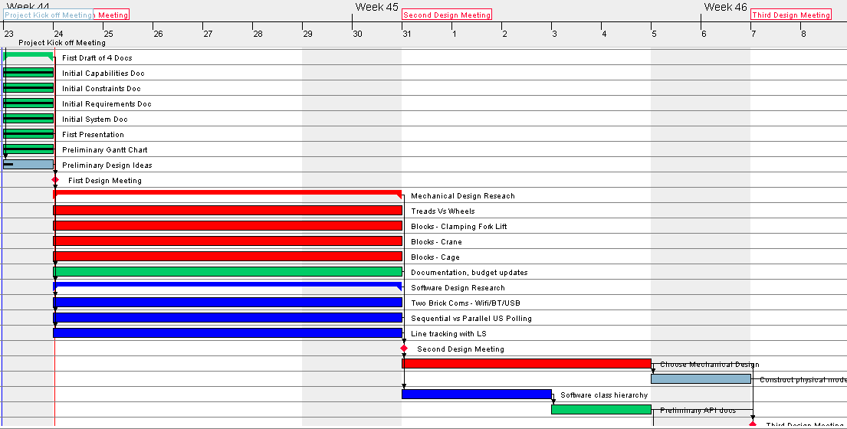
Preliminary Gantt Chart

Slide 4
Constraints
Environmental Issues:
Lighting
Boards
Hardware Constraints:
EV3 Kits
Batteries
Software Constraints
Java
Threads
Filtering
Resource Constraints:
Availability
Budget
Time, 9hrs/member/week

Slide 5
Requirements Scope
Purpose:
Builder
Garbage Collector
Scope:
Team Knowledge
Hardware Prototypes
Constraints
One or two bricks
Battery usage at least 5 mins
Footprint and weight
User Functions
Autonomous after execution
Connects with Wifi Server
Operating Environment
Floor
Discontinuities between planks
Lines
Ultrasonic noise
Performance:
Sensor operating frequency
Power efficient

Slide 6
Requirements Compatibility
Component Re-use:
Some code re-use from labs
Some algorithm re-use from labs
Third Party Products:
Wifi Module and Connection

Slide 7
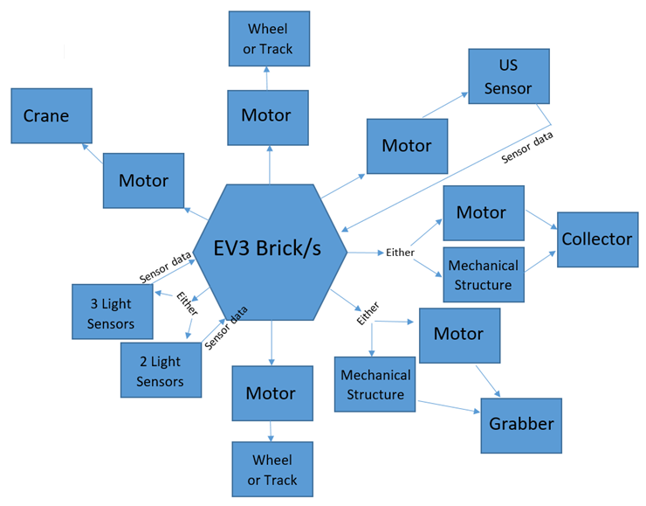
System Model

Slide 8
System
Hardware:
Mechanical
Electromechanical
Electronics Processor
Software:
Java
LeJos
Eclipse
Slack
Github
LaTeX/Overleaf
GANTTPROJECT
Constraints
One or two bricks
Battery usage at least 5 mins
Footprint and weight
User Functions
Autonomous after execution
Connects with Wifi Server
Operating Environment
Floor/lines
Discontinuities between planks
Ultrasonic noise
Performance:
Sensor operating frequency
Power efficient

Slide 9
Preliminary Design Ideas
Block Collection (On back of robot):
Clamping Fork Lift
Crane
Cage
Odometry:
Line tracking
Periodic Correction with Light Sensors
Collection Strategies:
Travel to Red/Green and radially travel outwards for blocks
Multiple Bricks:
Master/Slave
Slave brick polls sensors and Master requests asynchronously

